Slide 1








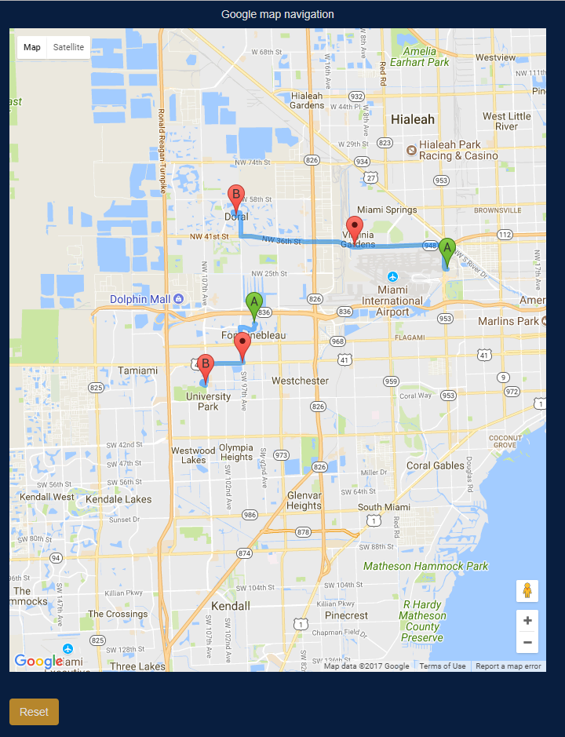
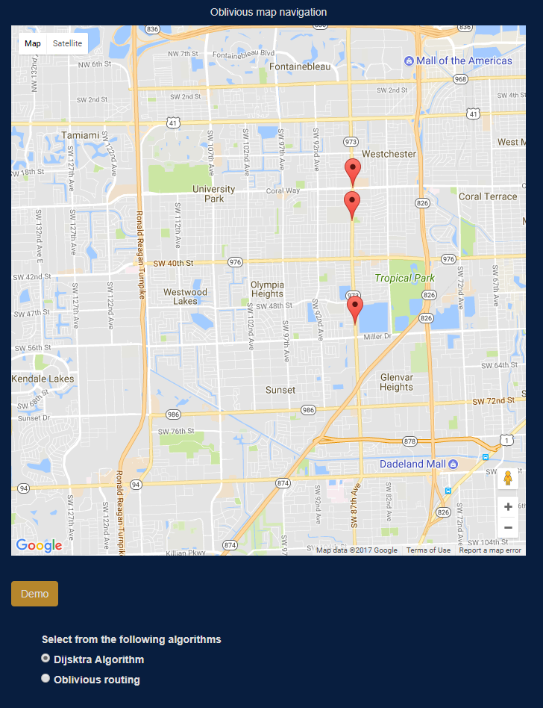
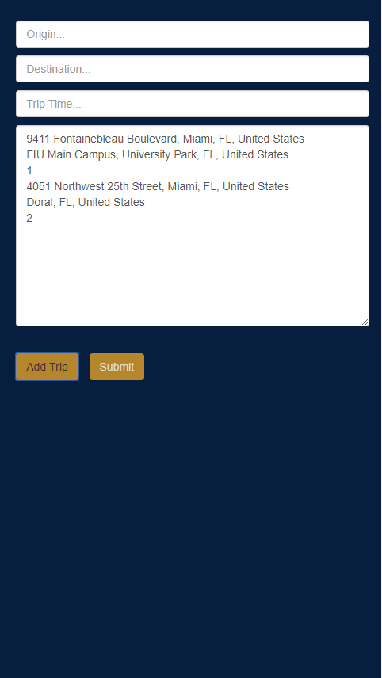
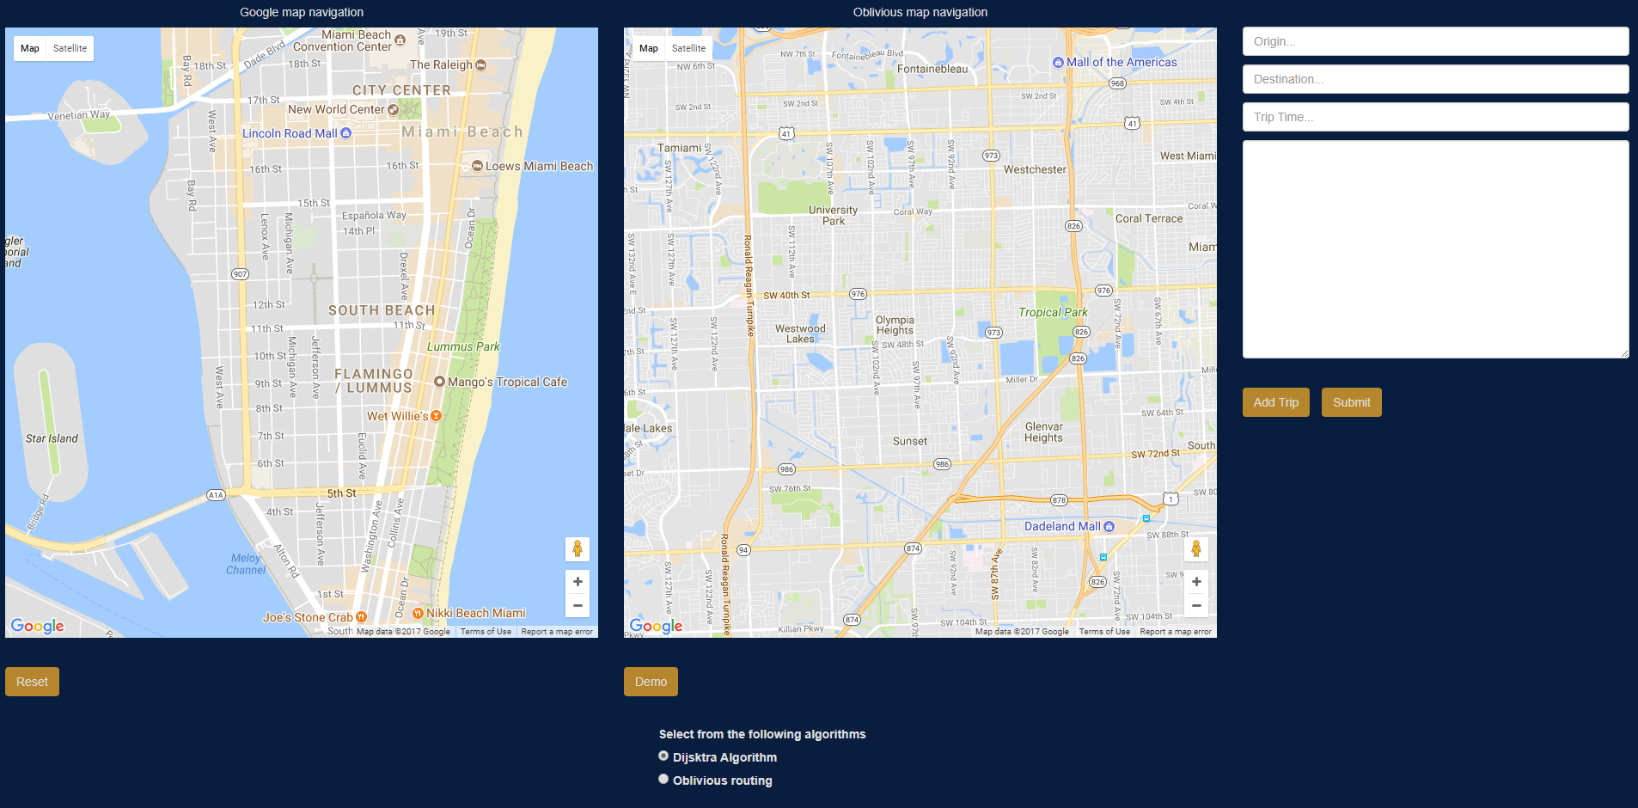
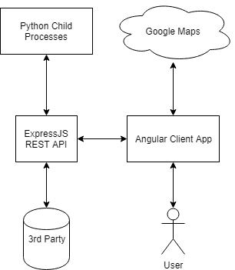
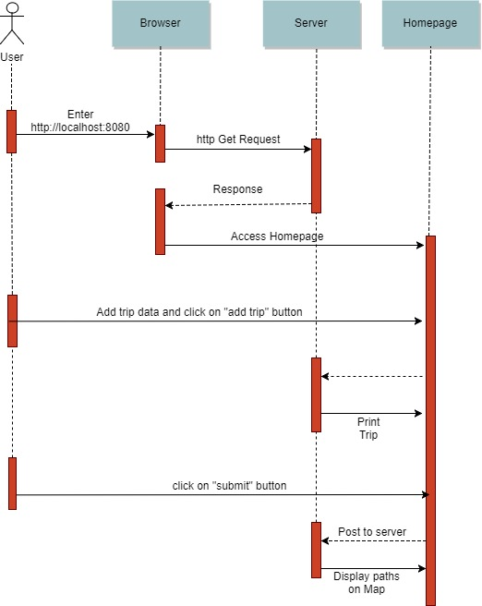
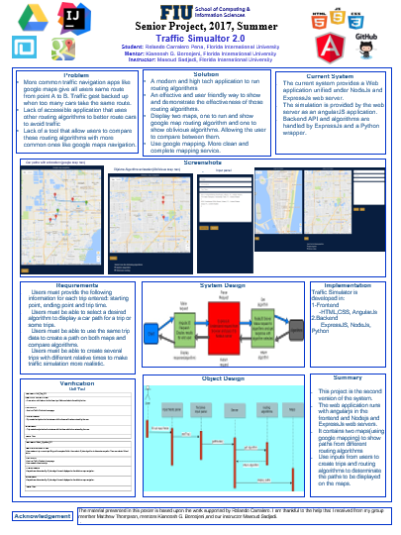
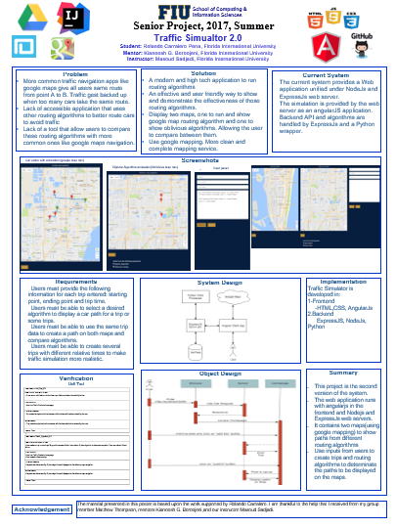
School of Computing & Information Sciences
Senior Project, 2017, Summer
Traffic Simualtor 2.0
Student: Rolando Carralero Pena, Florida International University
Mentor: Kianoosh G. Boroojeni, Florida International University
Instructor: Masoud Sadjadi, Florida International University
Problem
More common traffic navigation apps like google maps give all users same route from point A to B. Traffic gest backed up when too many cars take the same route.
Lack of accessible application that uses other routing algorithms to better route cars to avoid traffic
Lack of a tool that allow users to compare these routing algorithms with more common ones like google maps navigation.
Solution
A modern and high tech application to run routing algorithms
An effective and user friendly way to show and demonstrate the effectiveness of those routing algorithms.
Display two maps, one to run and show google map routing algorithm and one to show oblivious algorithms. Allowing the user to compare between them.
Use google mapping. More clean and complete mapping service.
Current System
The current system provides a Web application unified under NodeJs and ExpressJs web server.
The simulation is provided by the web server as an angularJS application.
Backend API and algorithms are handled by ExpressJs and a Python wrapper.
Screenshots
.
Car paths with animation (google map nav)
Dijsktra Algorithm animation(Oblivious map nav)
Input panel
Requirements
Users must provide the following information for each trip entered: starting point, ending point and trip time.
Users must be able to select a desired algorithm to display a car path for a trip or some trips.
Users must be able to use the same trip data to create a path on both maps and compare algorithms.
Users must be able to create several trips with different relative times to make traffic simulation more realistic.
System Design
Implementation
Traffic Simulator is developed in:
1-Frontend
-HTML,CSS, AngularJs
2.Backend
ExpressJS, NodeJs, Python
Verification
Unit Test
Object Design
Summary
This project is the second version of the system.
The web application runs with angularjs in the frontend and Nodejs and ExpressJs web servers.
It contains two maps(using google mapping) to show paths from different routing algorithms
Use inputs from users to create trips and routing algorithms to determinate the paths to be displayed on the maps.
Test case ID: Add_Trip_005
Description/Summary of Test: A user enters valid values into the three input fields and selects the add trip button
Pre-condition: User is at Traffic Simulator home page
Expected Results: Trip created and printed on the textarea with the three valid values entered by the user
Actual Result: Trip created and printed on the textarea with the three valid values entered by the user
Status : Pass
Test case ID: Select_Algorithm_001
Description/Summary of Test: User creates a trip or some trips filling out the required fields. User selects Dijkstra algorithm to determine car paths. Then user selects Submit button
Pre-condition: User is at Traffic Simulator home page User created at least one trip
Expected Results: Car paths are determined by Dijkstra algorithm and displayed on the oblivious map navigation.
Actual Result: Car paths are determined by Dijkstra algorithm and displayed on the oblivious map navigation.
Status : Pass
Acknowledgement
The material presented in this poster is based upon the work supported by Rolando Carralero. I am thankful to the help that I received from my group member Matthew Thompson, mentors Kianoosh G. Boroojeni,and our instructor Masoud Sadjadi.
.
Notes:
1

